Slide 1














PLAYER 1
HIGHSCORE 2500
PLAYER 2
Name of Game
CAPE FLATS CHRONICLES

Slide 2













01
07
12
MEMBERS
PEOPLE WHO PARTICIPATED IN THE MAKING OF THE GAME
Hakeem
Ben
Matt
Wandipa

Slide 3

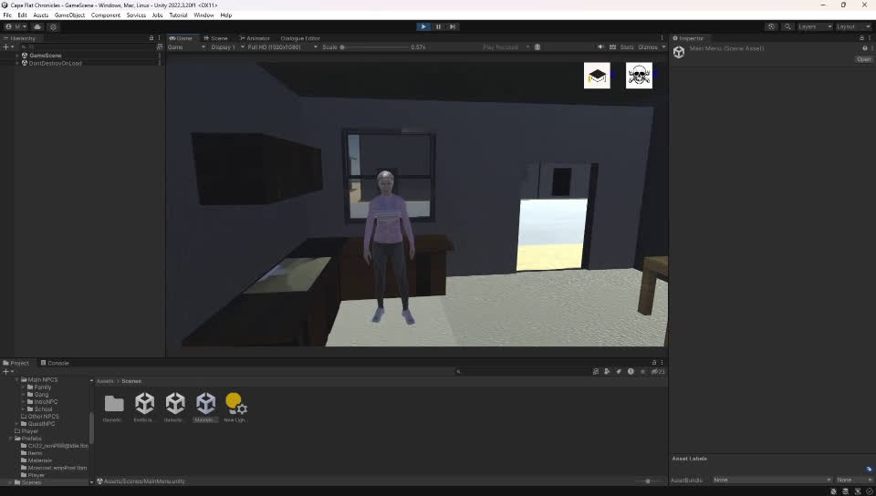

01
07
12
WHAT IS CAPE FLATS CHRONICLES?
STORY DRIVEN GAME
SET IN THE CAPE FLATS
FOLLOW THE LIFE OF A TEENAGE GIRL
SURVIVE THE ISSUES THAT YOUR NIEBOURHOOD HAS SUCCUMB TO
Back to
Agenda Page

Slide 4
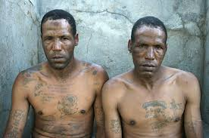
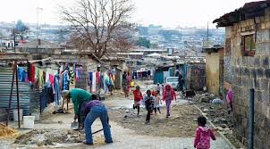
Gang Violence
PROBLEMS GAME IS SET TO ADRESS
NUMBERS GANGS
NOTORIOUS IN THE CAPE FLATS
Poverty
POVERTY IS A HUGE ISSUE WITHIN SOUTH AFRICA
Back to Agenda Page
LEADS TO CRIMES

Slide 5


TARGET AUDIENCE & DEMOGRAPHIC
STUDENTS
TEACHERS/EDUCATORS
CASUAL GAMERS
YOUNG ADULTS
15-30
STORY DRIVEN PLAYERS
People, the targets our game is aimed for.

Slide 6

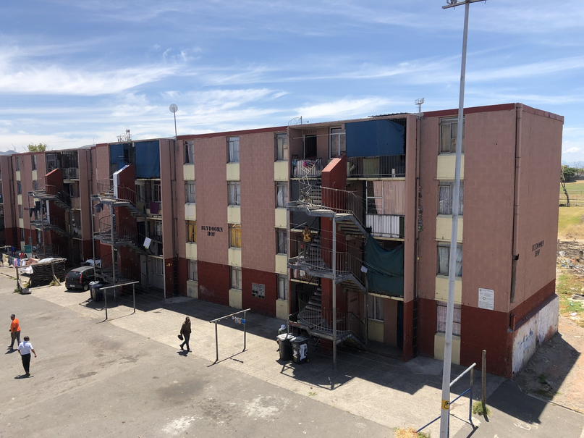
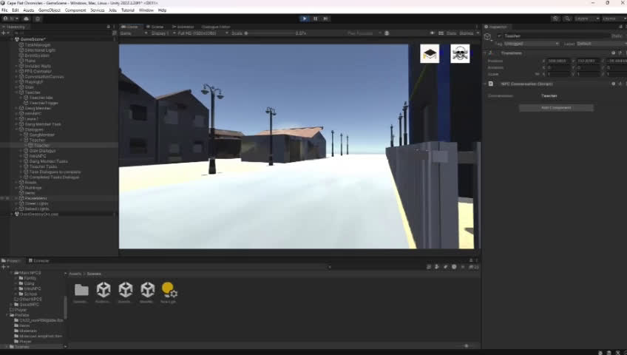
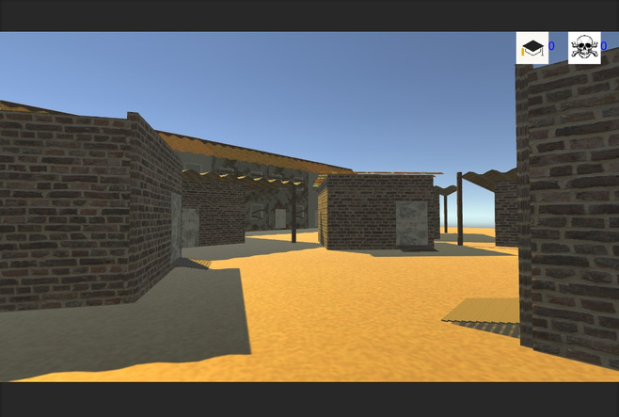

PLAYER 1
Game Setting
The Cape Flats
Poverty.
Crime.
Unhealthy Conditions.

Slide 7
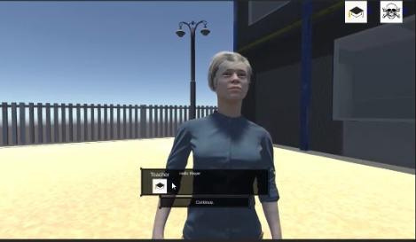
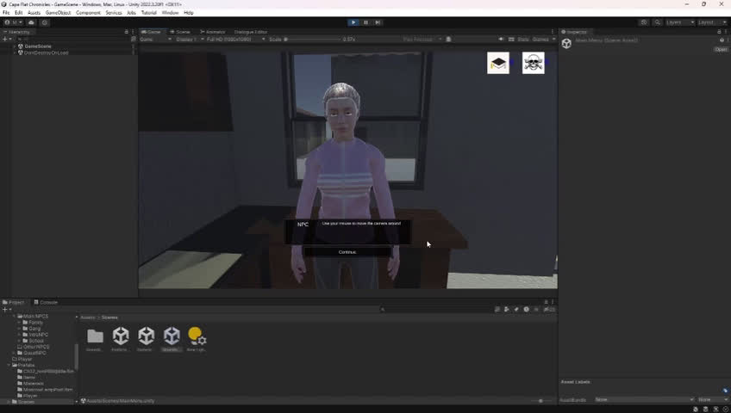
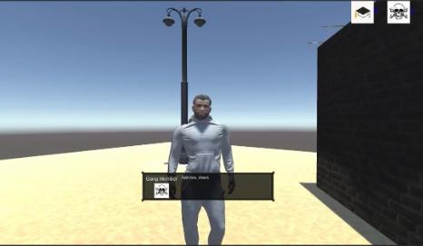
PLAYER 1
Gameplay Mechanics
Interactive Narrative Adventure
Stats based Game
Decision-Making
Acquire tasks from Npc’s
Your paragraph text

Slide 8




Low Poly style
Set in the Western Cape
Shacks
Cape Flats
Nitty Gritty Environment
Concept Art
CA IDEAS
Gunshot Sounds/ Taxi’s Hooting etc
Npc’s will convey a lower class appearance
People in our world will cultivate our environment
Shacks
Homeless people
Dirty roads
Cape Flats

Slide 9
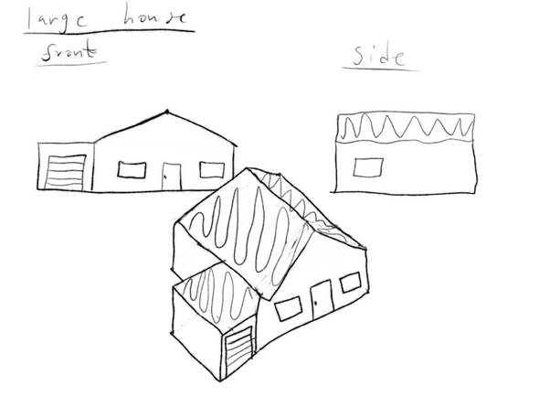
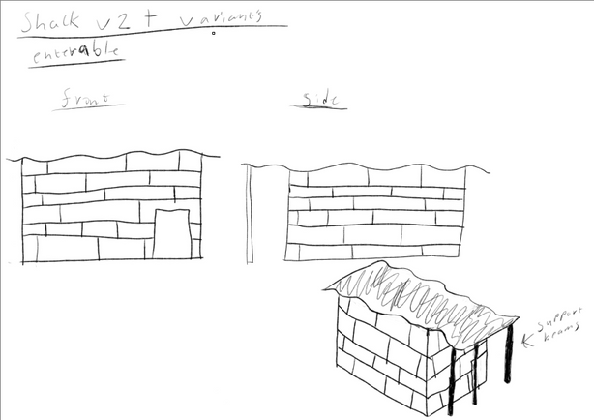
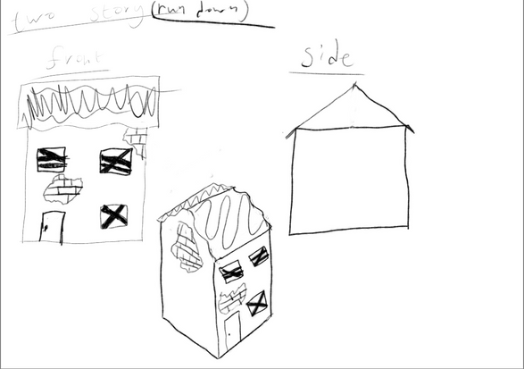
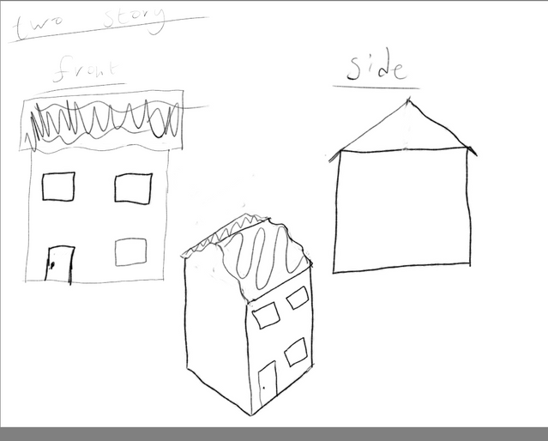
BUILDING CONCEPT IDEAS
Simple Sketches on how the buildings will look

Slide 10







THANK YOU!
CREATORS OF THE CAPE FLATS CHHRONICLES THANKS YOU FOR LISTENING TO OUR PRESENTATION.

